Slide 1
Micro-Credit Defaulter Model
CHRIS CHHOTAI
JAN 2022

Slide 2

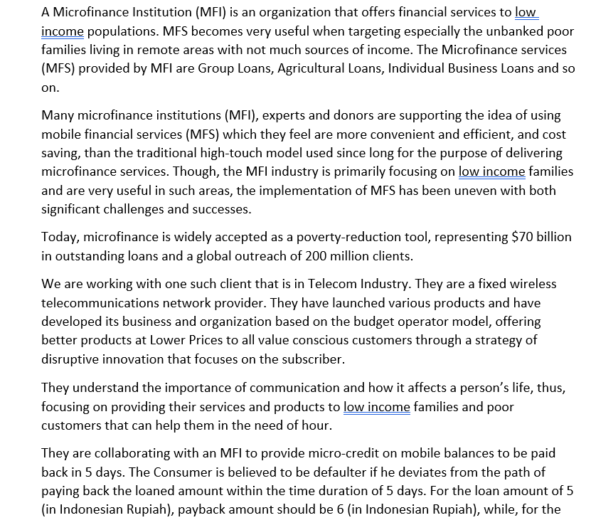
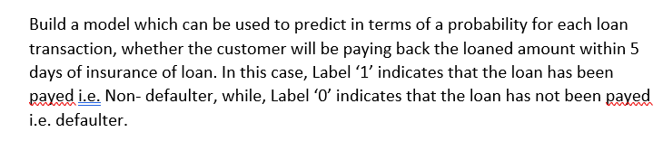
Problem Overview

Slide 3
Conceptual Background of the Domain Problem
MACHINE LEARNING AND DATA SCIENCE FOR BUSINESS:
Machine learning is a field of artificial intelligence (AI) and computer science that uses data and algorithms to mimic how humans learn from experience, make predictions, and improve their accuracy over time. It's an important part of the rapidly expanding discipline of data science. Algorithms are trained to generate classifications or predictions using statistical approaches, revealing crucial insights in data mining initiatives. Following that, these insights drive decision-making within applications and enterprises, with the goal of influencing important growth KPIs. As the market for big data expands and grows, so will the demand for data science, which will necessitate assisting in the identification of the most pertinent business issues and, as a result, the data to answer them. The following are some of the ways that data science can help.
• Providing management and officials with the tools they need to make better decisions.
• Taking measures based on trends, which aid in the definition of objectives.
• Encouraging employees to embrace best practises and concentrate on topics that matter.
• Recognizing opportunities.
• Using quantitative, data-driven evidence to make decisions.
• Putting these decisions to the test.
• Identifying and fine-tuning target audiences.

Slide 4
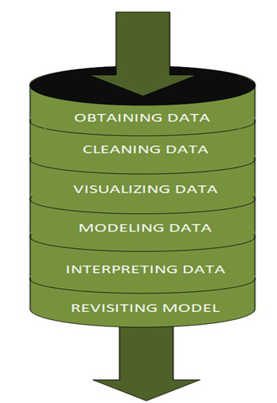
DATASCIENCE PIPELINE:
The data science pipeline is a set of interconnected tasks aimed at providing a firm with an insightful data science product or services. Collecting, cleaning, investigating, modelling, analysing data, and other product launch processes are among the task. "This final output can be used to meet business objectives."
Exploratory Data Analysis (EDA) & IT’s TYPES:
The primary goal of EDA is to assist in the analysis of data prior to making any assumptions. It can aid in the detection of evident errors, as well as a better understanding of data patterns, the detection of outliers or unusual events, and the discovery of interesting relationships between variables. Exploratory analysis can be used by data scientists to guarantee that the results they create are accurate and appropriate to any targeted business outcomes and goals. EDA also assists stakeholders by ensuring that they are asking the correct questions.
TYPES OF EXPLORATORY DATA ANALYSIS:
Univariate Non-graphical
Multivariate Non-graphical
Univariate graphical
Multivariate graphical

Slide 5
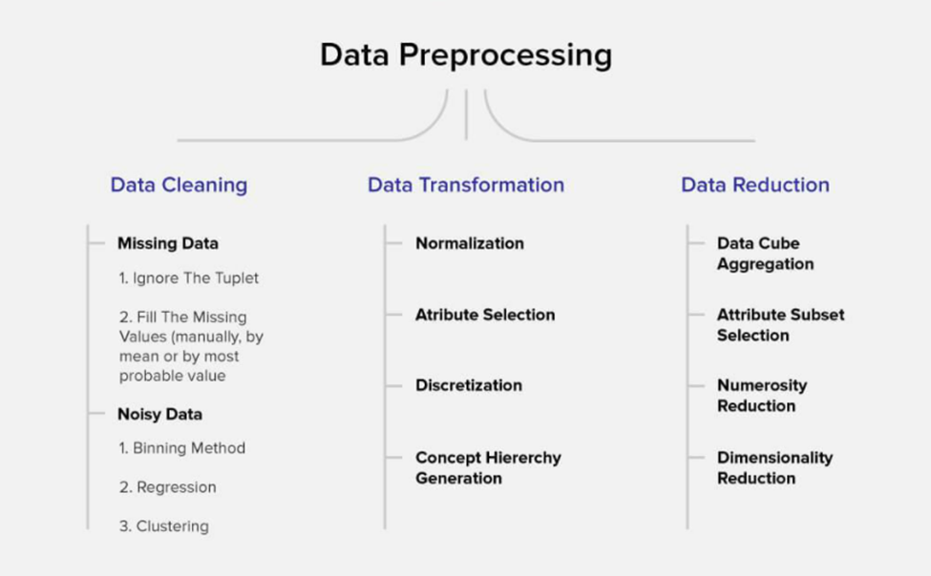
DATA PRE-PROCESSING
Data pre-processing is a critical component of machine learning models because it prepares raw data and makes it appropriate for efficient machine learning models. These are the data preprocessing methods, and we will employ the ones that are required in our project.

Slide 6
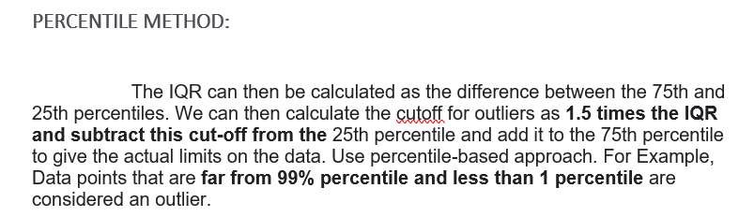
FEATURE ENGINEERING
Variance Inflation Factor (VIF)
In least squares regression models, variance inflation factors (VIFs) evaluate the correlation between independent variables. Multicollinearity is the term used by statisticians to describe this type of association. Excessive multicollinearity can cause regression models to fail. Let's import the stats models package, which contains the VIF library.
SKEWNESS REMOVAL-(POWER-TRANSFORM):
A power transform will make a variable's probability distribution more Gaussian.This is often referred to as removing a skew in the distribution, although it's more commonly referred to as reducing the variance of the distribution. The Sklearn, Pre-processing package includes a power-transform library.
MINMAX SCALER:
The MinMax Scaler lowers the data to fit inside a given range, which is commonly 0 to 1. It scales the values to a given range of values. Because we can only execute skewness removal and scaling on input data, we must train test divide the data before scaling.
TRAIN TEST SPLIT:
The train test split() module in the scikit-learn Python machine learning package implements the train-test split evaluation procedure. The function accepts a supplied dataset and splits it into two subgroups as an output. The function train test split() divides an array of data into random sections. For training and testing, an 80:20 split is thought to be best.

Slide 7


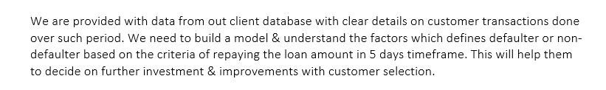
Review of Literature
ABSTRACT:

Slide 8
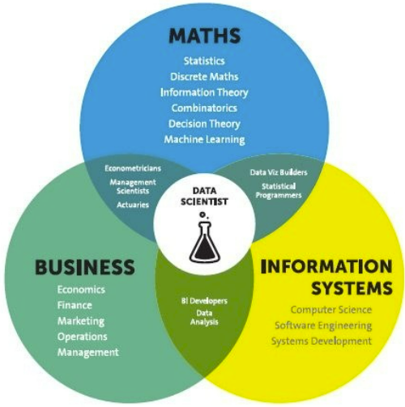
Analytical Problem Framing
Mathematical / Statistical / Analytical Modeling - are three of the most important concepts of Data Science. Data Science revolves around these three fields and draws their concepts to operate on the data.
Mathematical Modelling:
Mathematical models are vital, and choosing the appropriate one to address a business question can be quite beneficial to a company. It is crucial in cutting-edge technologies such as Machine Learning, Artificial Intelligence, Data Science, and Deep Learning, among others. It's because every algorithm in today's technologies has a mathematical function that aids in pattern recognition.
For the implementation of such algorithms in data science, a thorough understanding of numerous concepts in statistics and probability theory is required.Regression, Maximum Likelihood Estimation, comprehension of distributions (Binomial, Bernoulli, Gaussian (Normal)), and Bayes' Theorem are some of the terms used.
The main reason for a greater significance of mathematics is because of its various concepts like: –
Linear Algebra
Probability
Calculus – Differential & Integral Calculus
Statistics
Descriptive (Mean, Median, Mode, IQR, Std. deviation, Z & T- Statistics, linear regression)
Inferential (Sampling, Confidence interval, chi-square, ANOVA)

Slide 9
Analytical Problem Framing
Regression Models:
Regression models are used by data analysts to investigate the relationships between variables. Organizations frequently utilize regression models to discover which independent variables have the greatest impact on dependent variables—information that may be used to make critical business choices.
Classification Models:
An algorithm is used to assess an existing data set of known points in the classification process. The knowledge gained from the study is then used to categorise the data appropriately. Classification is a type of machine learning that can be very useful in assessing huge, complicated datasets and making more accurate predictions.

Slide 10
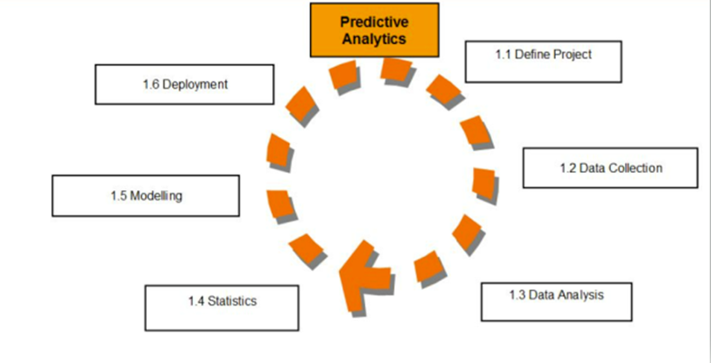
Analytical Models:
An analytical model is quantitative in nature, and used to answer a specific question or make a specific design decision.
Different analytical models are used to address different aspects of the system, such as its performance, reliability, or mass properties. Data analysis comes with the fundamental types of data analytics encounter in data science: Descriptive, Diagnostic, Predictive, and Prescriptive.
Descriptive analytics is a statistical method that is used to search and summarize historical data in order to identify patterns or meaning.
Descriptive analysis is often used when reviewing any past or present data. This is because raw data is difficult to consume and interpret, while the metrics offered by descriptive analysis are much more focused.
The example of descriptive statistics or analytics is to calculate the mean, median mode, standard deviation, and similar kinds of statistical calculation on finance or sales data.
Diagnostic analytics takes it a step further to uncover the reasoning behind certain results. Diagnostic analytics is usually performed using such techniques as data discovery, drill-down, data mining, and different type of bivariant data analysis like correlations. etc.,
Predictive Analytics is a statistical method that utilizes algorithms and machine learning to identify trends in data and predict future behaviors. Predictive Analytics can take both past and current data and offer predictions of what could happen in the future.
Predictive models typically utilize variability in data to make the correct prediction and more variability of ingredient data that shows the relationship with what is possible to predict that united together into a prediction or valid score.
Prescriptive analytics automatically synthesizes big data, mathematical sciences, business rules, algorithms, and machine learning to make predictions and then suggests decision options to take advantage of the predictions. Prescriptive means (optimization and simulation).

Slide 11

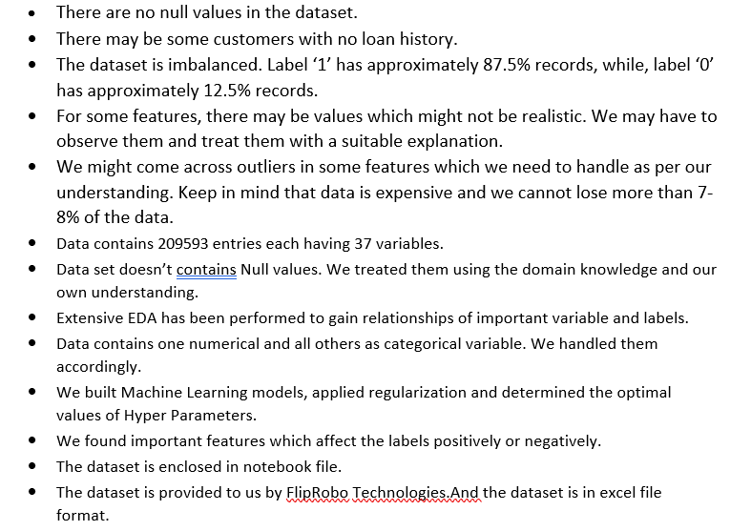
Data Sources and their formats

Slide 12
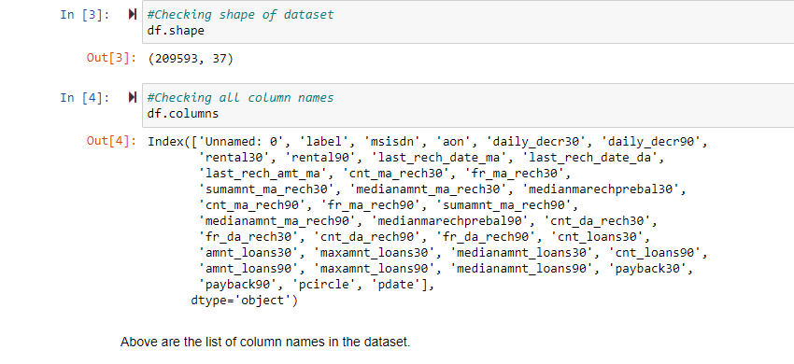
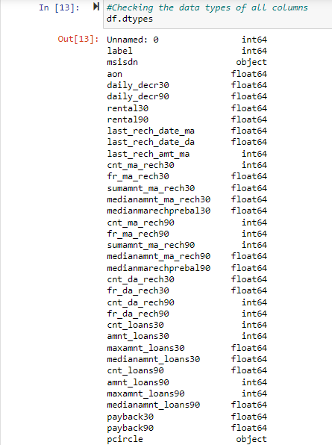
Data Description

Slide 13
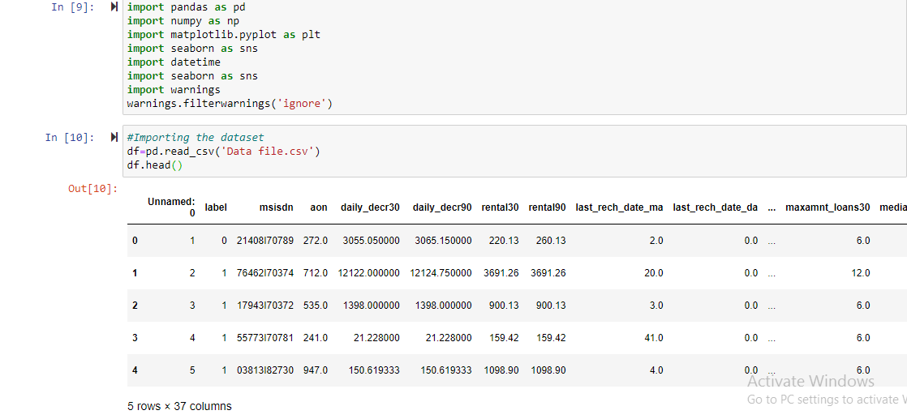
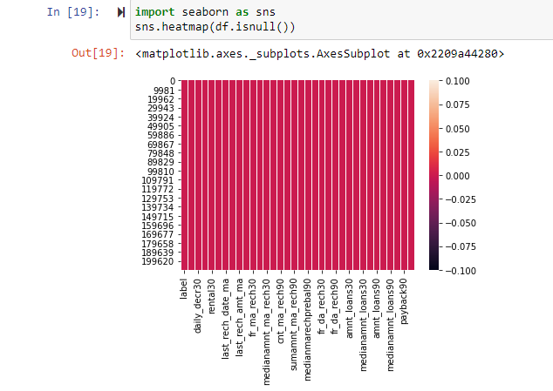
DATA ACQUISITION

Slide 14
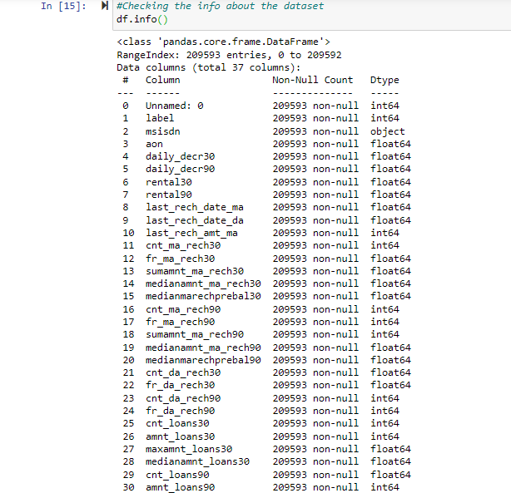
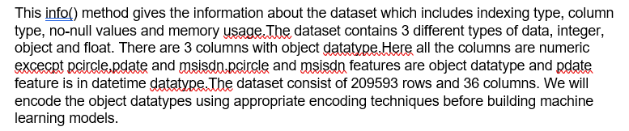
FEATURE DESCRIPTION:
Following are the features and their data type details,

Slide 15
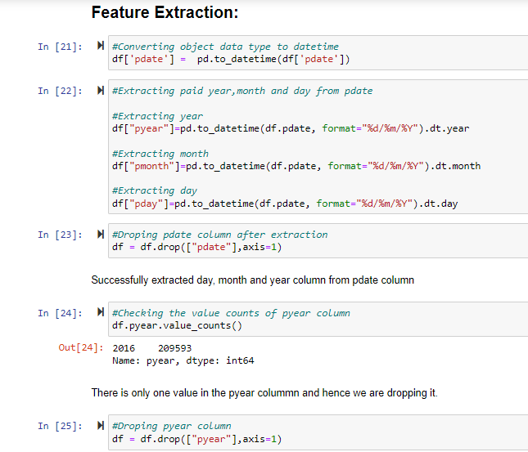
Feature Extraction:

Slide 16
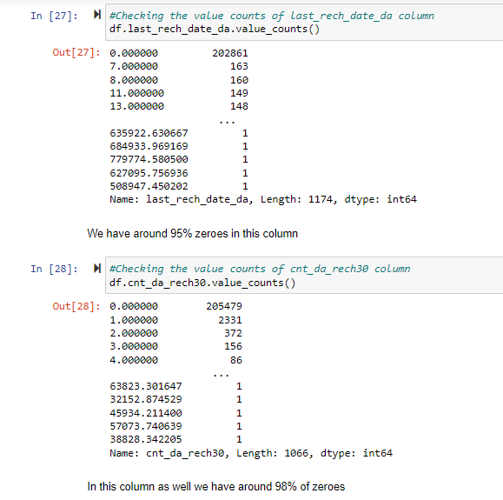
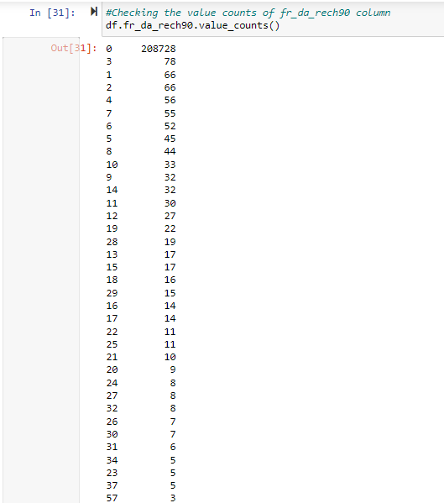
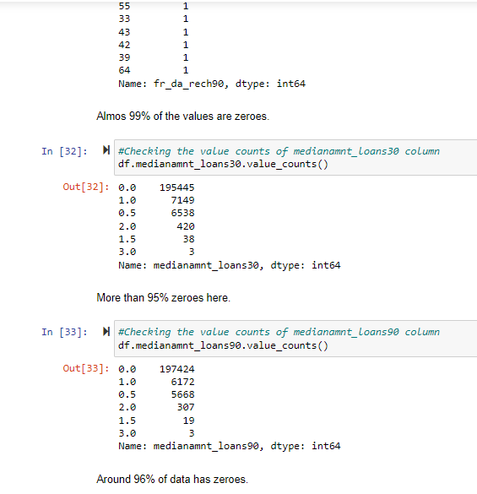
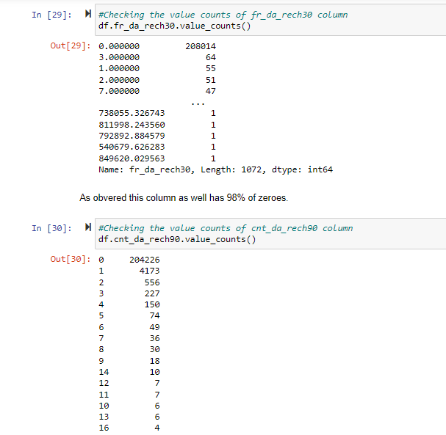
Data Analysis and Preprocessing

Slide 17
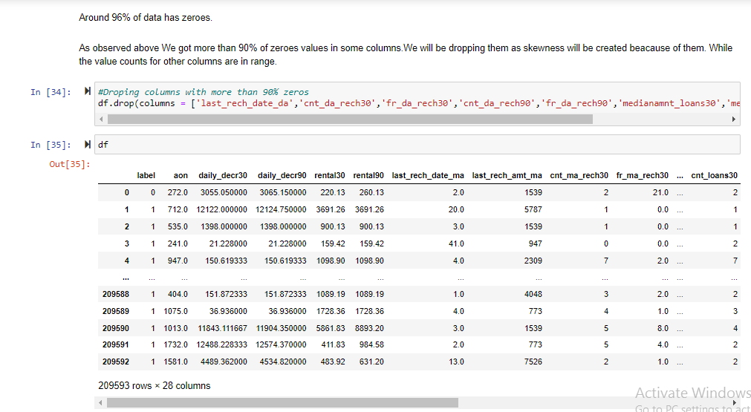
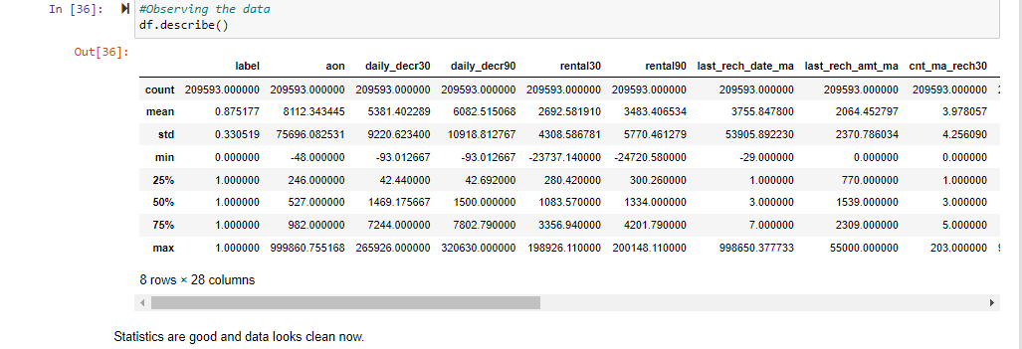
Data Analysis and Preprocessing

Slide 18
Data Inputs- Logic- Output Relationships
In Classification, the output variable must be a discrete value.
In classification, inputs are divided into two or more classes, and the learner must produce a model that assigns unseen inputs to one (or multi-label classification) or more of these classes. This is typically tackled in a supervised way.
In machine learning, classification refers to a predictive modeling problem where a class label is predicted for a given example of input data. A classification model attempts to draw some conclusion from observed values. Given one or more inputs a classification model will try to predict the value of one or more outcomes. The output variables are often called labels or categories.
A classification can have real-valued or discrete input variables. A problem with two classes is often called a two-class or binary classification problem. A problem with more than two classes is often called a multi-class classification problem. A classification algorithm, in general, is a function that weighs the input features so that the output separates one class into positive values and the other into negative values.
Classification is a data mining function that assigns items in a collection to target categories or classes. The goal of classification is to accurately predict the target class for each case in the data. For example, a classification model could be used to identify loan applicants as low, medium, or high credit risks.
Classification analysis is a data analysis task within data-mining, that identifies and assigns categories to a collection of data to allow for more accurate analysis.
Classification analysis can be used to question, make a decision, or predict behaviour through the use of an algorithm.

Slide 19
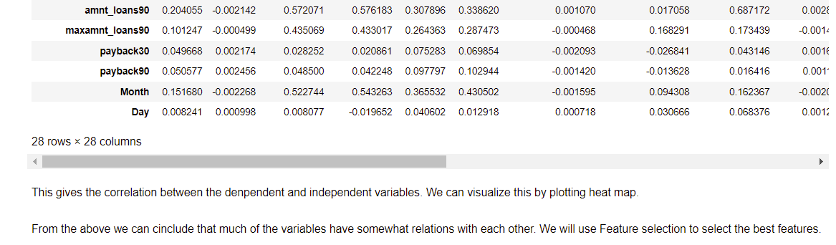
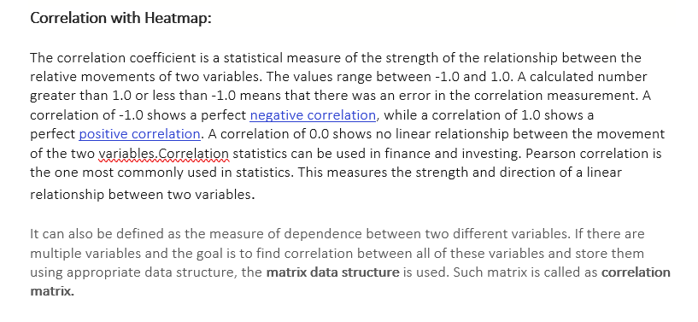
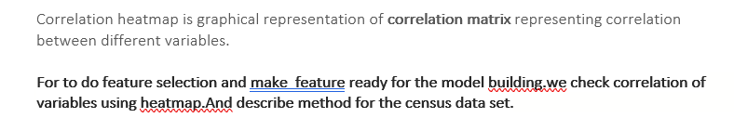
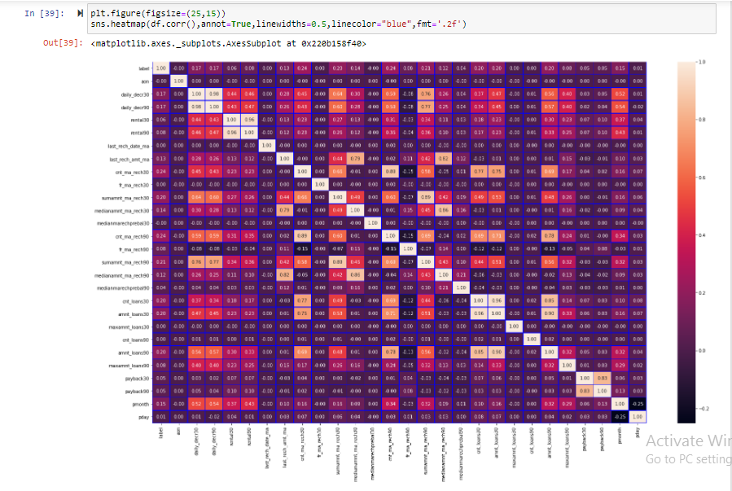
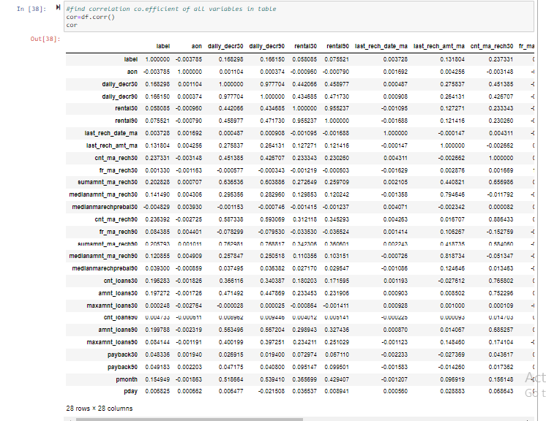
Data Pre-processing & Feature Engineering

Slide 20
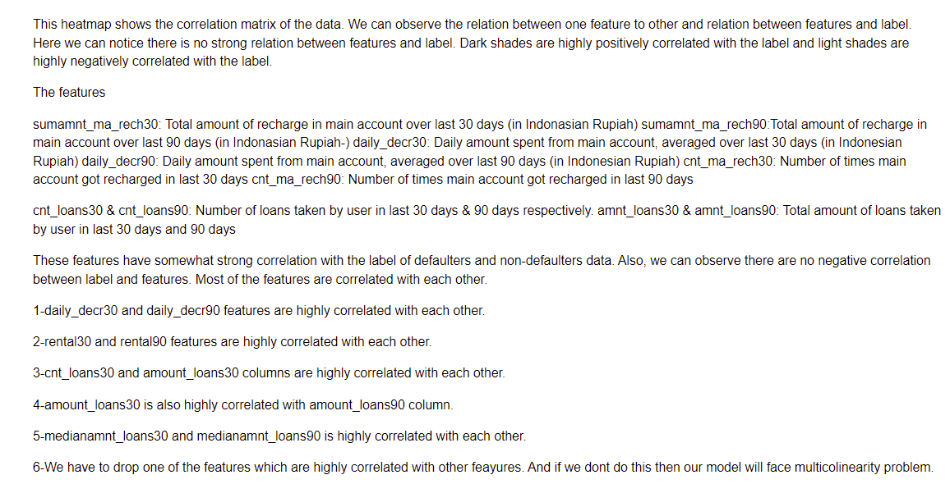
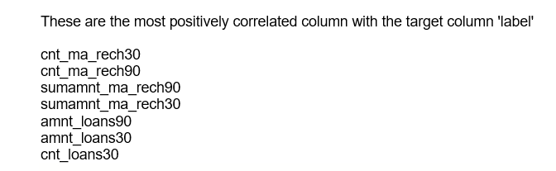
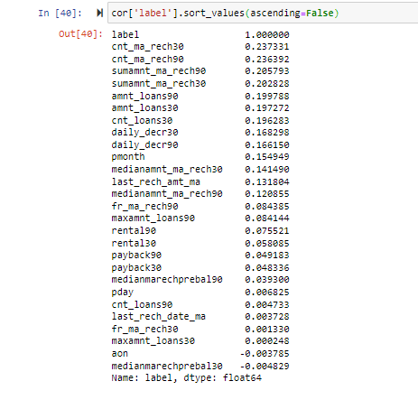

Slide 21
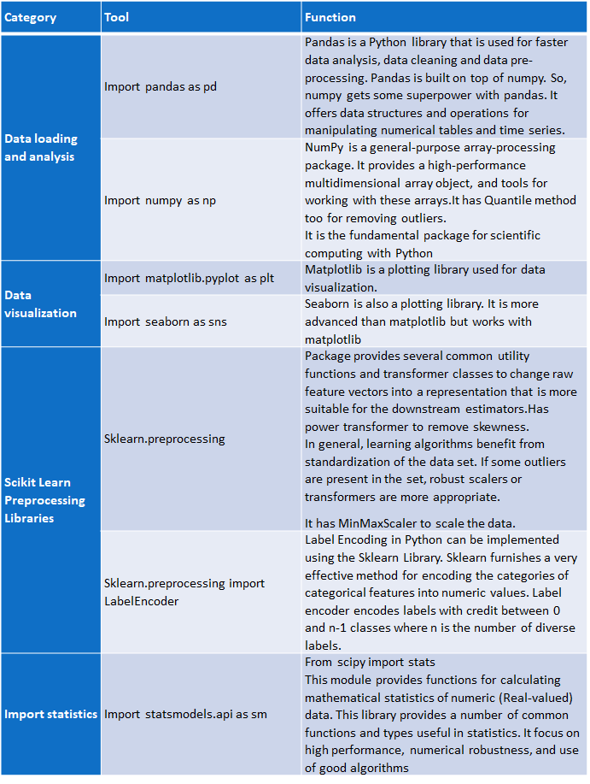
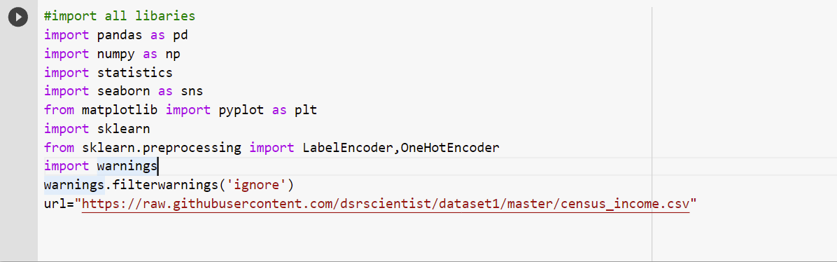
HARDWARE & SOFTWARE TOOLS, LIBRARIES & PACKAGES USED:
Hardware :Intel i7,RAM 16GB used.
Software: Jupyter Notebook (Anaconda 3)
Language: Python
Libraries:
Pandas
Numpy
Matplotlib
Seaborn
Sklean
Scipy
Statsmodels
Pip-Package install Manager

Slide 22


An algorithm is used to assess an existing data set of known points in the classification process. The knowledge gained from the study is then used to categorize the data appropriately. Classification is a type of machine learning that can be very useful in assessing huge, complicated datasets and making more accurate predictions.
The most commonly used Performance metrics for classification problem are as follows,
• Accuracy.
• Confusion Matrix.
• Precision, Recall, and F1 score.
• ROC AUC.
Grid search is used as an approach to hyper-parameter tuning that will methodically build and evaluate a model for each combination of algorithm parameters specified in a grid. GridSearchCV helps us combine an estimator with a grid search preamble to tune hyper-parameters.
Cross-validation is a technique in which we train our model using the subset of the data-set and then evaluate using the complementary subset of the data-set.
The three steps involved in cross-validation are as follows :
1. Reserve some portion of sample data-set.
2. Using the rest data-set train the model.
3. Test the model using the reserve portion of the data-set.
The most important use of PCA is to represent a multivariate data table as smaller set of variables (summary indices) in order to observe trends, jumps, clusters and outliers. This overview may uncover the relationships between observations and variables, and among the variables.
Also import all the required algorithms for classification purpose below

Slide 23
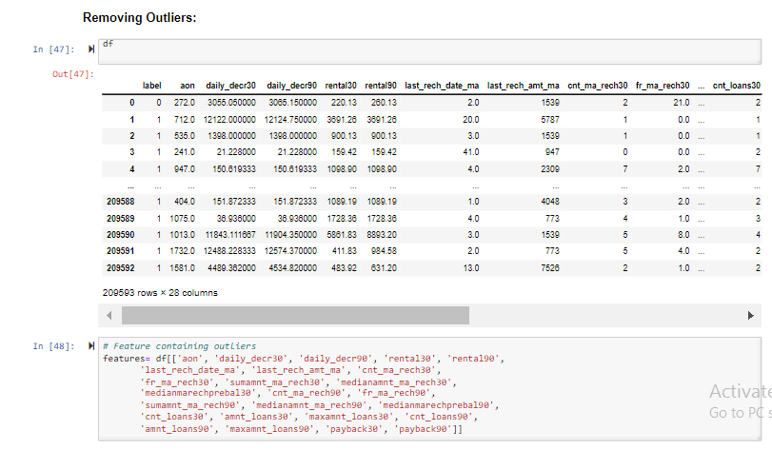
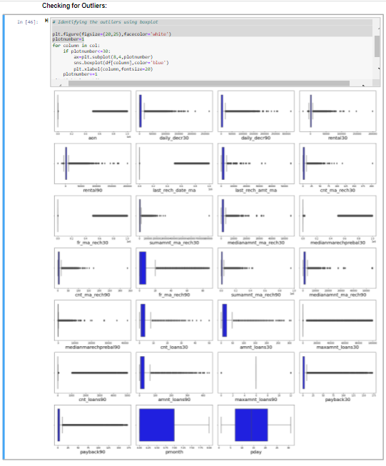
Model/s Development and Evaluation
Identification of possible problem-solving approaches (methods)

Slide 24
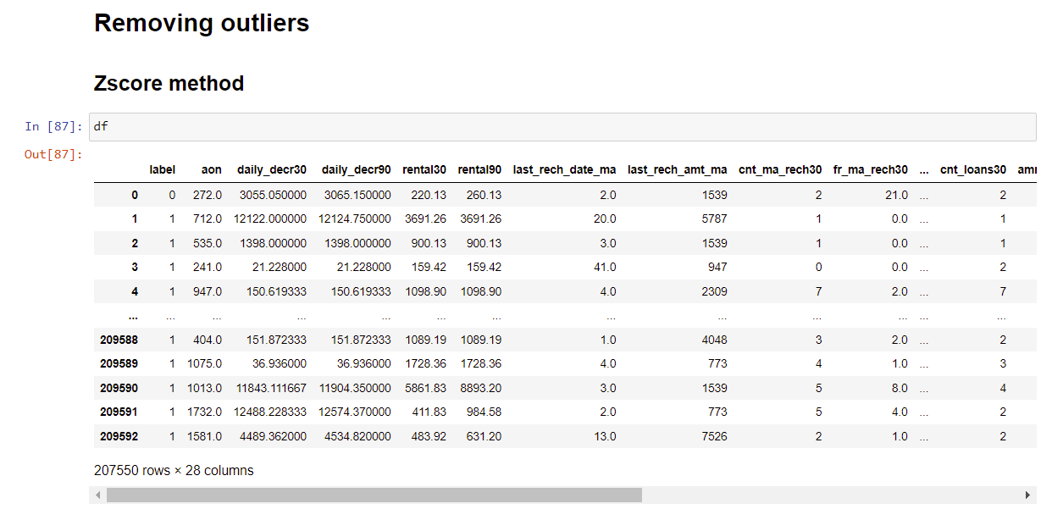
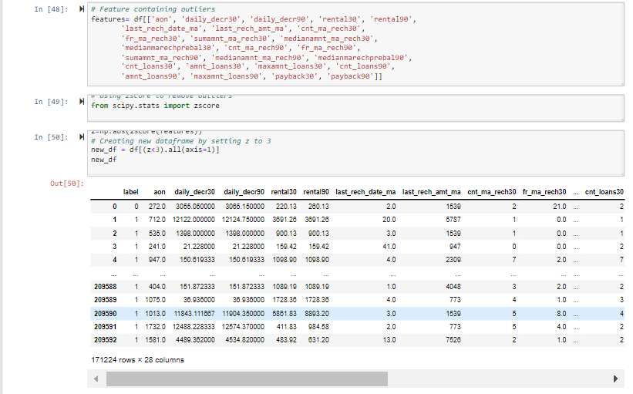
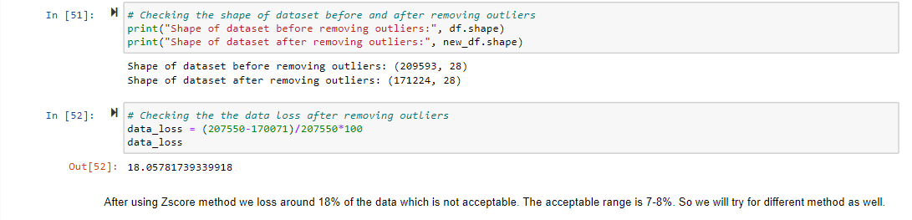

Slide 25
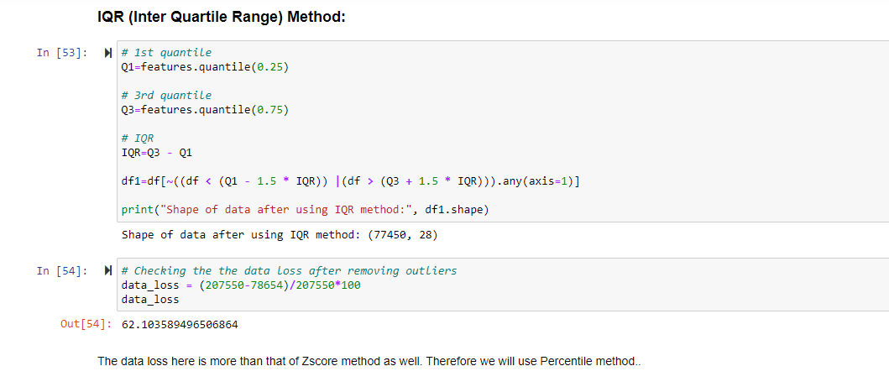
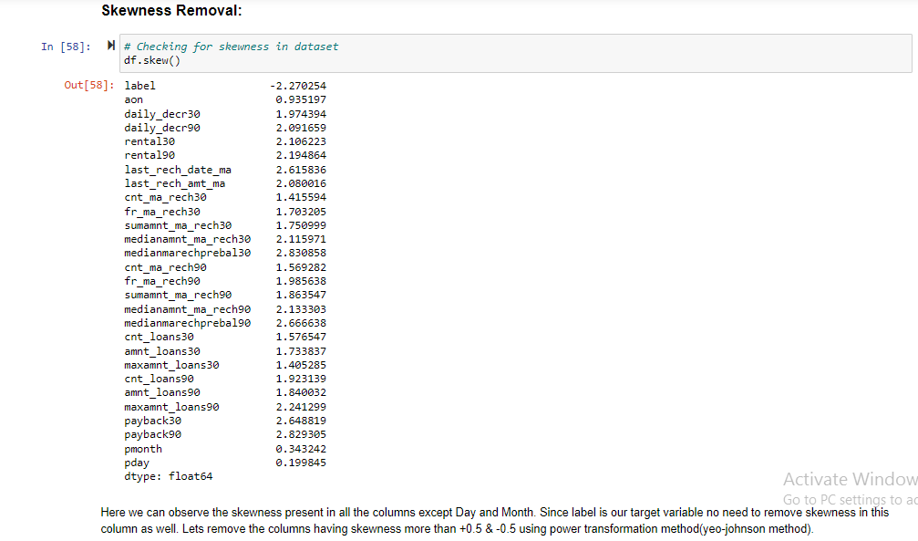
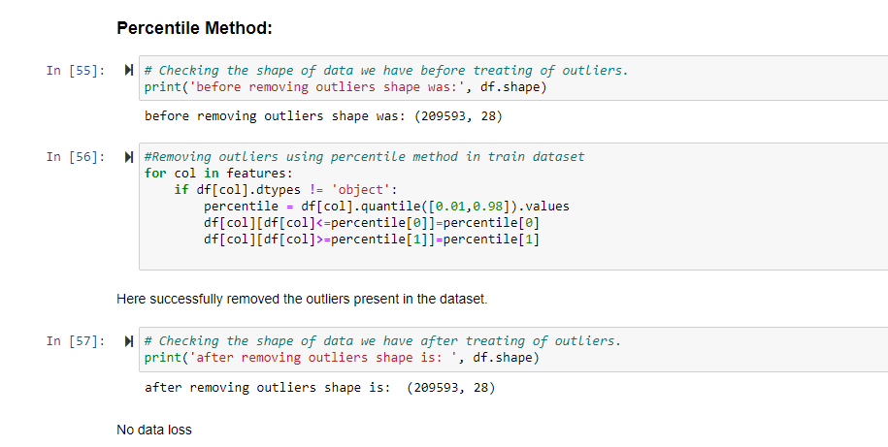
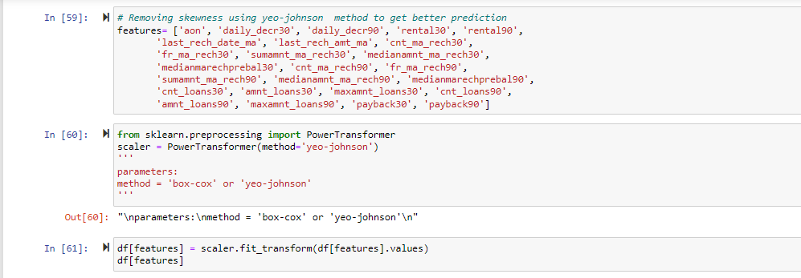

Slide 26
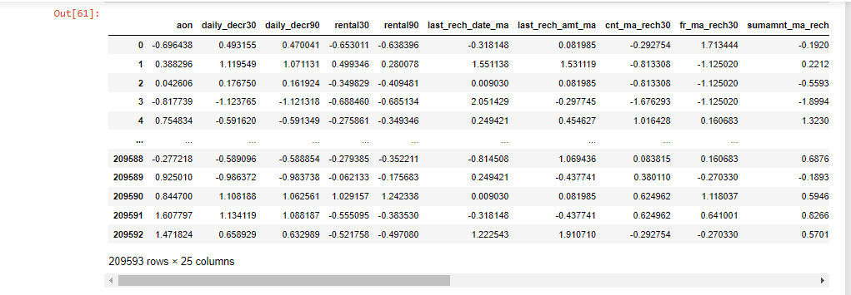
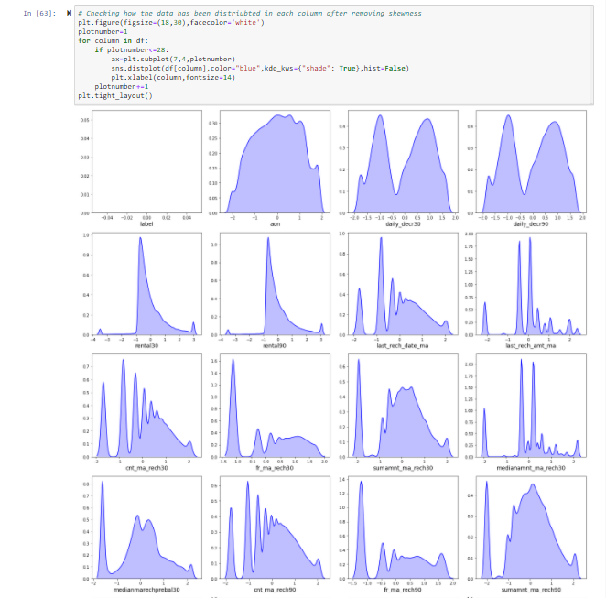
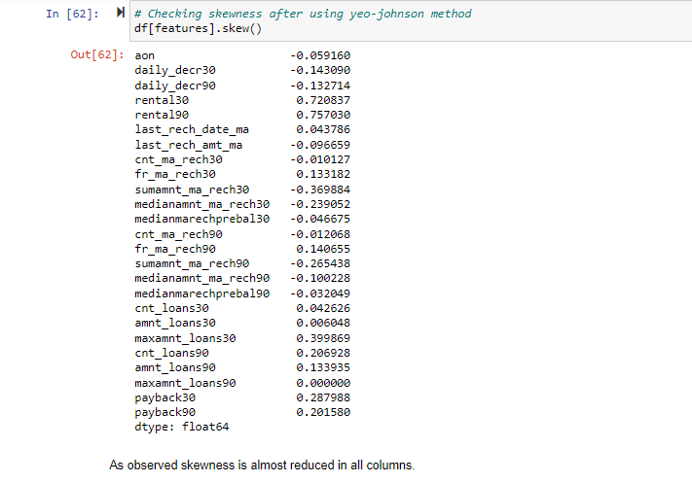

Slide 27
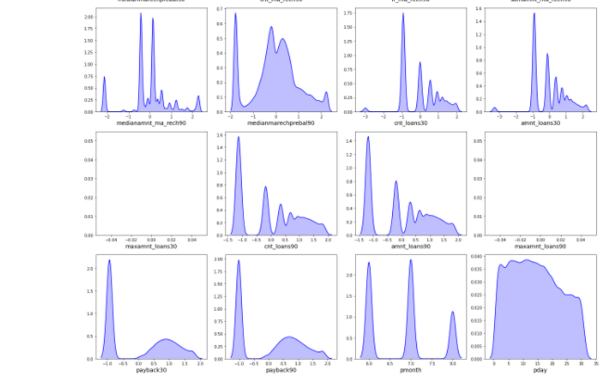
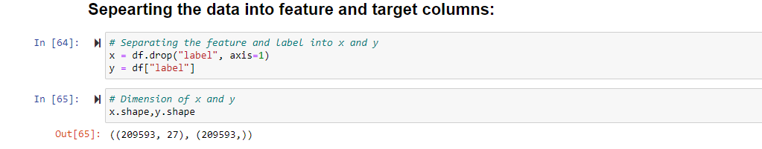
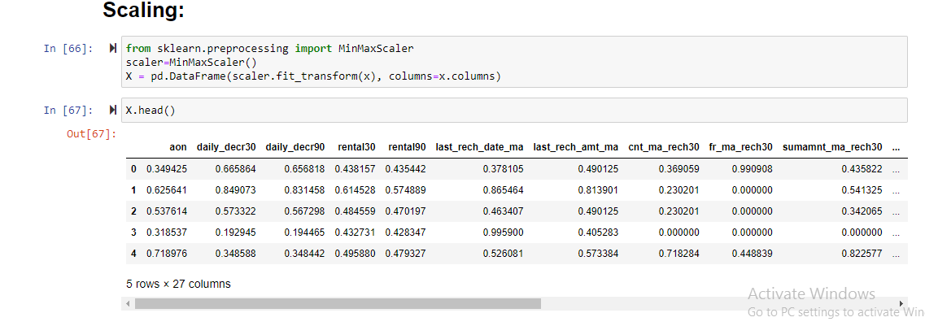

Slide 28
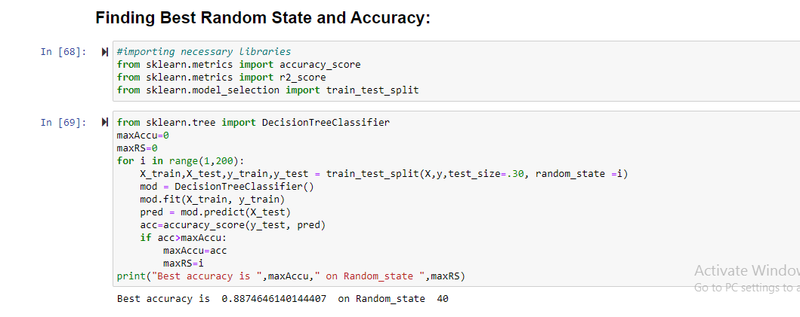

Slide 29
Testing of Identified Approaches (Algorithms)
These are all the Algorithms used for Model Building and Prediction. We did Hyper Parameter Tuning with these algorithms using the GridSearchCV.
Logistic Regression
DecisionTree Classifier
Bagging Classifier
AdaBoost Classifier
These algorithms has been used for both Training and Testing purpose and got evaluated with classification metrics such as f1score,confusion matrix, precision, recall and AUC ROC curve etc.,

Slide 30
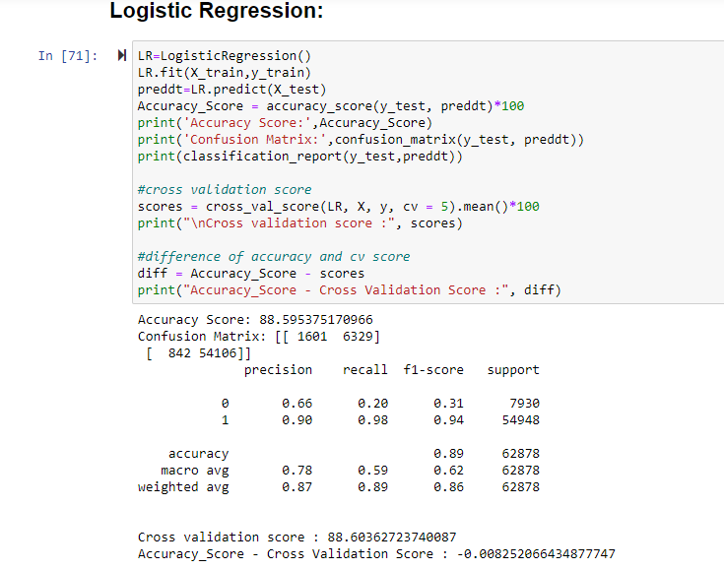
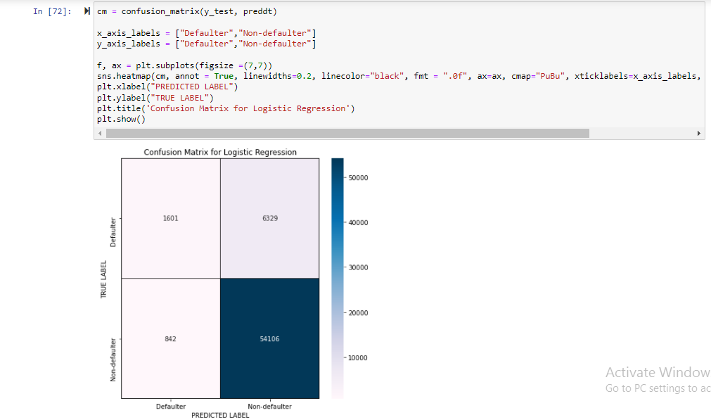
Run and Evaluate selected models
LOGISTIC REGRESSION:
Logistic regression is used to describe data and to explain the relationship between one dependent binary variable and one or more nominal, ordinal, interval or ratio-level independent variables. Logistic regression is a simple and more efficient method for binary and linear classification problems. It is a classification model, which is very easy to realize and achieves very good performance with linearly separable classes. It is an extensively employed algorithm for classification. Logistic Regression is used when the dependent variable(target) is categorical.

Slide 31


DECISION TREE CLASSIFIER:
The main advantage of the decision tree classifier is its ability to using different feature subsets and decision rules at different stages of classification. Decision tree often involves higher time to train the model. Decision tree training is relatively expensive as the complexity and time has taken are more. The Decision Tree algorithm is inadequate for applying regression and predicting continuous values. In this, the data is continuously split according to a certain parameter. The tree can be explained by two entities, namely decision nodes and leaves.

Slide 32


BAGGING CLASSIFIER:
A Bagging classifier is an ensemble meta-estimator that fits base classifiers each on random subsets of the original dataset and then aggregate their individual predictions (either by voting or by averaging) to form a final prediction. Such a meta-estimator can typically be used as a way to reduce the variance of a black-box estimator (e.g., a decision tree), by introducing randomization into its construction procedure and then making an ensemble out of it.

Slide 33


ADABOOST Classifier:
An AdaBoost classifier is a meta-estimator that begins by fitting a classifier on the original dataset and then fits additional copies of the classifier on the same dataset but where the weights of incorrectly classified instances are adjusted such that subsequent classifiers focus more on difficult cases.

Slide 34



Visualizations

Slide 35



Slide 36



Slide 37



Visualizations

Slide 38




Slide 39



Slide 40


Interpretation of the Results
MODEL SAVING:

Slide 41


Slide 42
Conclusion:
KEY FINDINGS:
If the number of days to payback increases, the likelihood of defaulters increases as well. As a result, we should search for the payback period.
The number of defaulters increases when the loan amount is less than 100 and the number of loans taken by users is less than 90 days.
The following types of users are generally defaulters:
Users who are only using the services for a short period of time.
Users with a lower average daily spend amount.
Users with a low main account balance.
Users who have not recharged in the last 30 or 90 days or have only recharged a few times.
Users with a lower recharge amount.
Users who take out a smaller loan are more likely to default than those who take out a larger loan.

Slide 43
Thanks

